Slide 1
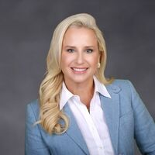
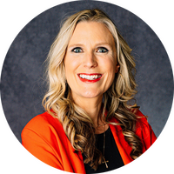
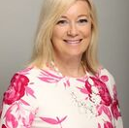
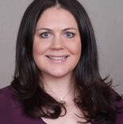
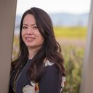
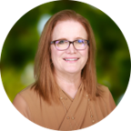
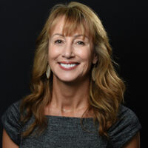
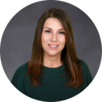
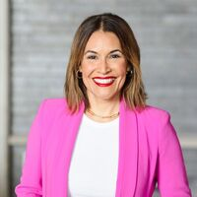
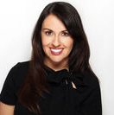
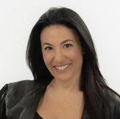
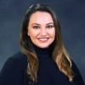
GLOBAL SALES – GROUP | North America
KATY GETTINGER
Vice President, Sales
Financial & Insurance
AMY BUTTERFIELD
Senior Vice President, Global Sales – Group
CHRISTIE PIENAAR
Vice President Group Sales –
SoCal, Utah, Nevada & Hawaii
JENNIFER COLLINS
Senior Director, Group Sales – NoCal, Pacific Northwest, Colorado,
Western Canada
KATE ANTHONY
Senior Director, Group Sales –
Mid-Atlantic, Carolinas, PA, OH, IN
ANNE CHAO
Director, Group Sales-
Northeast, Eastern Canada,
Pharma
PENNI LeROY
Director, Group Sales –
Texas, Oklahoma, Tennessee
MICHELLE SUKALA
Director, Group Sales –
Southeast
KATE NAWRACAJ
Director, Group Sales –
Midwest Corporate & Association
GABRIELA ROSENFELD
Director, Group Sales –
Midwest Incentive, Los Angeles
CRISTINA GODWIN
Director, Business Development
KARLY MOSS
Manager, Group Desk – North America
LIORA SULKIN
Director, Group Sales –
Mexico & Latin America
MICHELLE STREETER
Senior Director, Global Sales –Entertainment

Slide 2
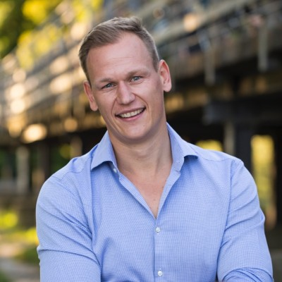
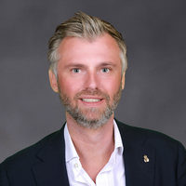
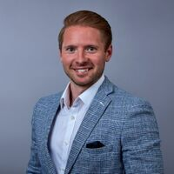
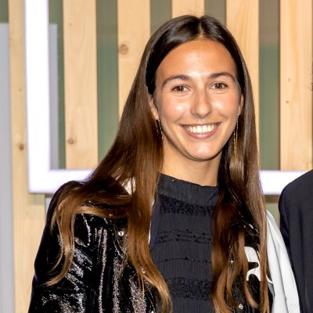
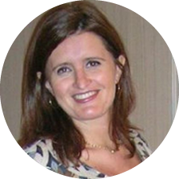
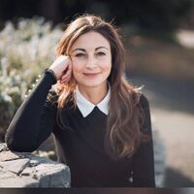
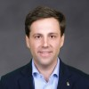
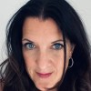
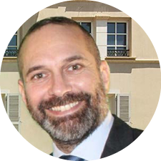
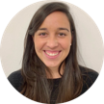
GLOBAL SALES – GROUP | Europe
MARKUS LUETHGE
Vice President, Global Sales – Group
MARK BEVERLO
Senior Director, Global Sales – Group
CALLUM DUCKWORTH
Director , Global Sales – Group
MARIE-LOUISE SEGUINET
Manager, Global Sales- Group
SILVIA LAVASSA
Director, Global Sales
EVA OLLER
Director, Global Sales
STEPHANE MARCET
Director, Global Sales
WENDIE ESPOSITO
Director, Global Sales
Entertainment
STEFAN SCHOEWEL
Director, Global Sales
CAROLINA BOURGHARDT
Senior Account Manager, Group Sales
ANTONY BALDWIN
Account Manager, Group Sales

Slide 3
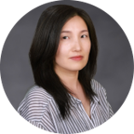
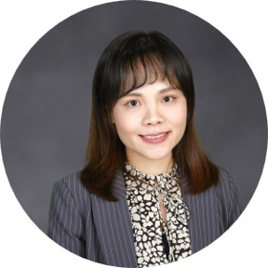
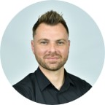
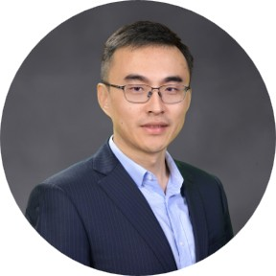
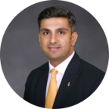
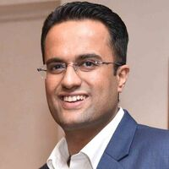
GLOBAL SALES – GROUP | ASPAC, China & Africa
CHERYL SIOW
Vice President, Global Sales –
China & ASPAC
ALICE CHOI
Director, Global Sales –
South Korea
SYLVIA MAK
Director , Global Sales –
Hong Kong & Taiwan
ASHLEY SHEN
Senior Manager, Global Sales- China
ESTELLE LIANG
Director, Regional Sales - China
FRANCOIS JOUBERT
Senior Manager, Sales
Africa
GALEN LU
Director, Global Sales –
China
SHAKUN KHANDELWAL
Senior Manager, Sales –
South Asia
MAYANK TUTEJA
Director, Sales –
South Asia

Slide 4
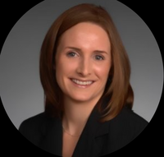
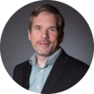
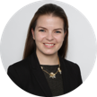
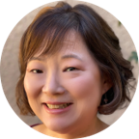
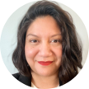
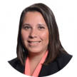
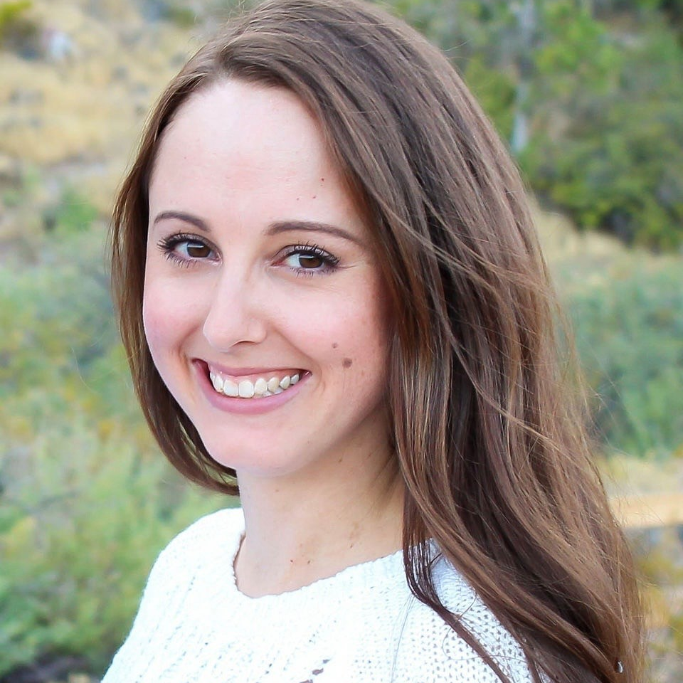
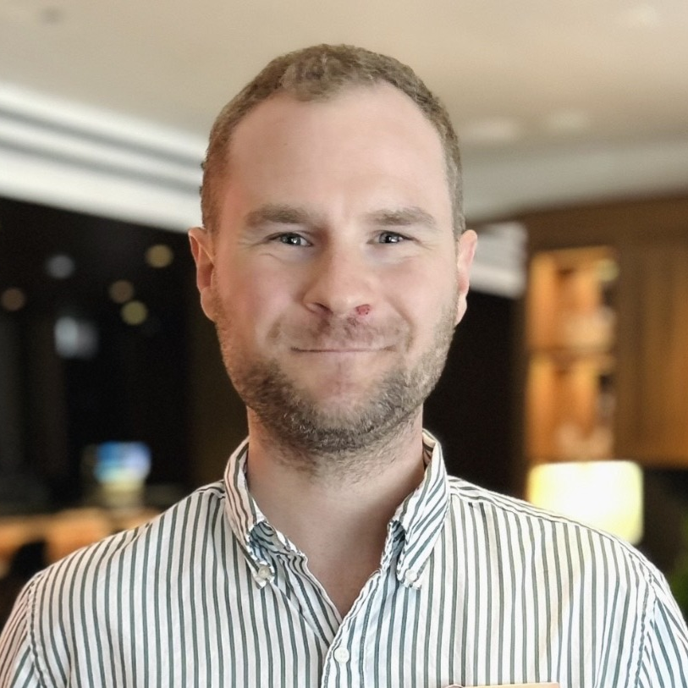
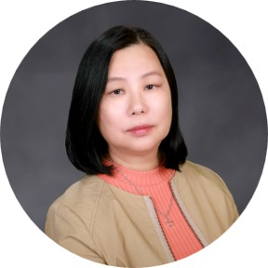
GLOBAL SALES – GROUP Sales Support
NICOLE NELSON
Director, Group Sales -
Account Management & Training
CAROL BOURGHARDT
Senior Account Manager, Group Sales -
Europe
SCOTT DeCHERRIE
Account Manager, Group Sales –
North America
VANESSA CONNELLY
Account Manager, Group Sales –
North America
KIMBERLY VINORAY
Account Manager, Group Sales –
North America
ZULLY SORIANO
Account Manager, Group Sales –
North America
YOLANDA WEST
Account Manager, Group Sales –
North America
ANTONY BALDWIN
Account Manager, Group Sales –
Europe
SINA RADEV
Account Manager, Group Sales –
North America
ERIC BOUMIL
Account Manager, Group Sales –
North America
MARJORIE SIOW
Manager, Administration
ASPAC

